Slide 1

California Geological Energy Management Division (CalGEM)
  Inglewood Oil Field Overview
  Baldwin Hills Conservancy – July 17, 2020
  Uduak-Joe Ntuk
  State Oil & Gas Supervisor
  California Geological Energy Management Division

Slide 2

Presentation Overview
State Oil & Gas Supervisor
COVID-19 Updates
Inglewood Oilfield Overview
CARB SNAPS Study
Questions & Answers

Slide 3

State Oil and Gas Supervisor
Uduak-Joe Ntuk is the 17th California ​State Oil and Gas Supervisor responsible for managing the California Geologic Energy Management Division. He was appointed by Governor Newsom in October 2019.​​​
​
Ntuk directs a statewide regulatory, technical, and field operations organization designed to emphasize the safe development of oil and natural gas conservation, which includes: protecting public health and safety, environmental quality, and the reduction and mitigation of greenhouse gas emissions associated with the development of hydrocarbon and geothermal resources in a manner that meets the energy needs of the state.
Full Biography: https://www.conservation.ca.gov/index/Pages/About-Us/Uduak-Joe-Ntuk.aspx
MS, Petroleum Engineering
University of Southern California
BS, Chemical Engineering
California State University, Long Beach

Slide 4


State Oil & Gas Supervisor’s Priorities
Strengthening our regulatory program to protect public health, safety, and the environment.
Consistent implementation of our regulations and processes across the state.
Enhanced public transparency and digitization for the public interest.
Ensure that operators safely decommission wells and infrastructure.
Build and train our workforce to rise to the challenges ahead.
Using science-based approach grounded in sound engineering practices to make decisions and inform our policies.

Slide 5
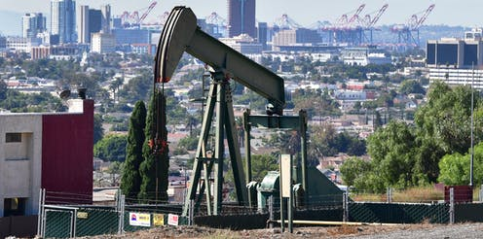
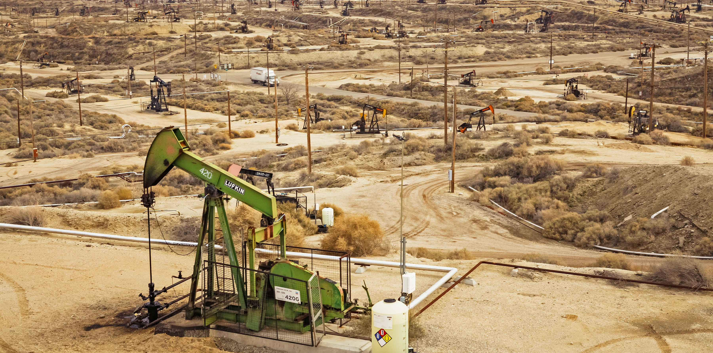
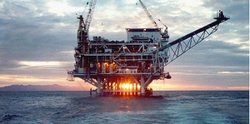
State Oil & Gas Initiatives
High Pressure Cyclic Steam Moratorium
Well Stimulation Scientific Review
Oil & Gas Public Health Rulemaking
Carbon Neutrality Study

Slide 6
CalGEM COVID-19 Impacts

Slide 7

COVID-19 Operational Impacts
  Safety First

Slide 8


COVID-19 CalGEM Update
  Permitting
  Administration
  Field Engineering

Slide 9
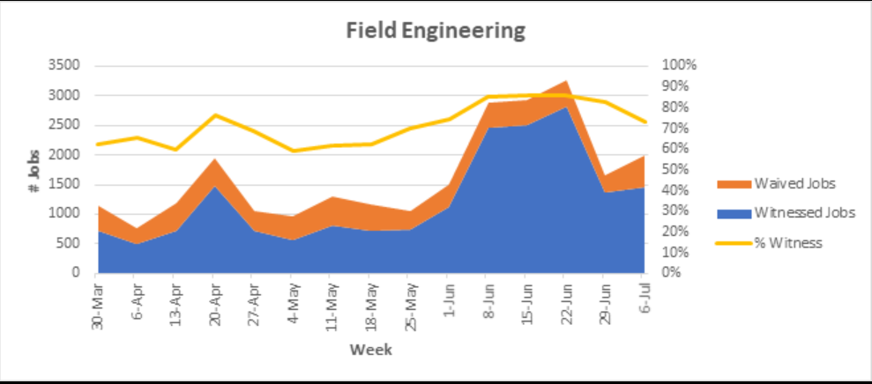
COVID-19 Impacts in the Field

Slide 10
Inglewood Oil Field Overview

Slide 11
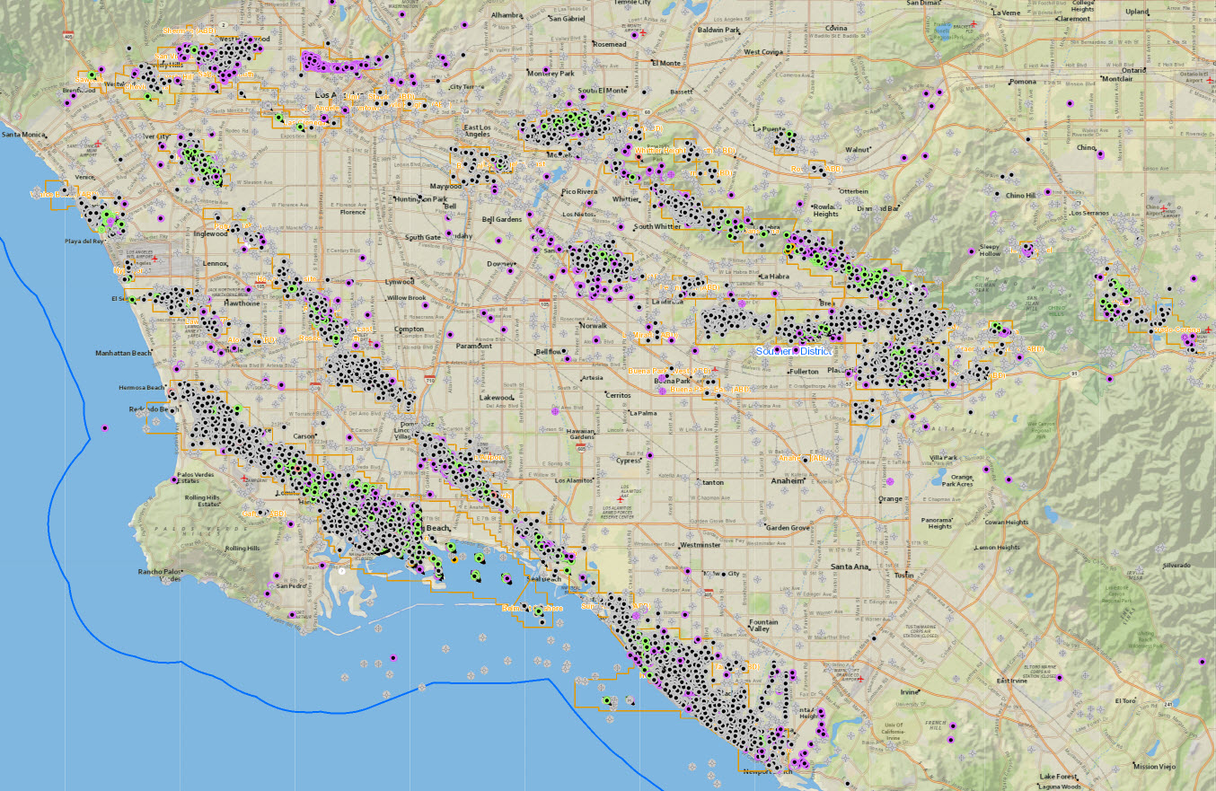
Los Angeles Basin Oil Fields
Beverly Hills
Los Angeles City
Montebello
Inglewood Oil Field
Inglewood Oil Field
Discovered in 1924
Operated by Sentinel Peak Resources since 2016
Segmented by the Newport-Inglewood fault
2 UIC projects on either side of the fault (West and East unit)
Playa del Rey
Gas Storage
Santa Fe Springs
Brea-Olinda
CalGEM
Long Beach
Wilmington
Offshore
THUMS Islands
(Wilmington)
Platform Esther
(Belmont)
Platforms Eva & Emmy
(Huntington Beach)
Huntington
Beach
Newport
Beach

Slide 12
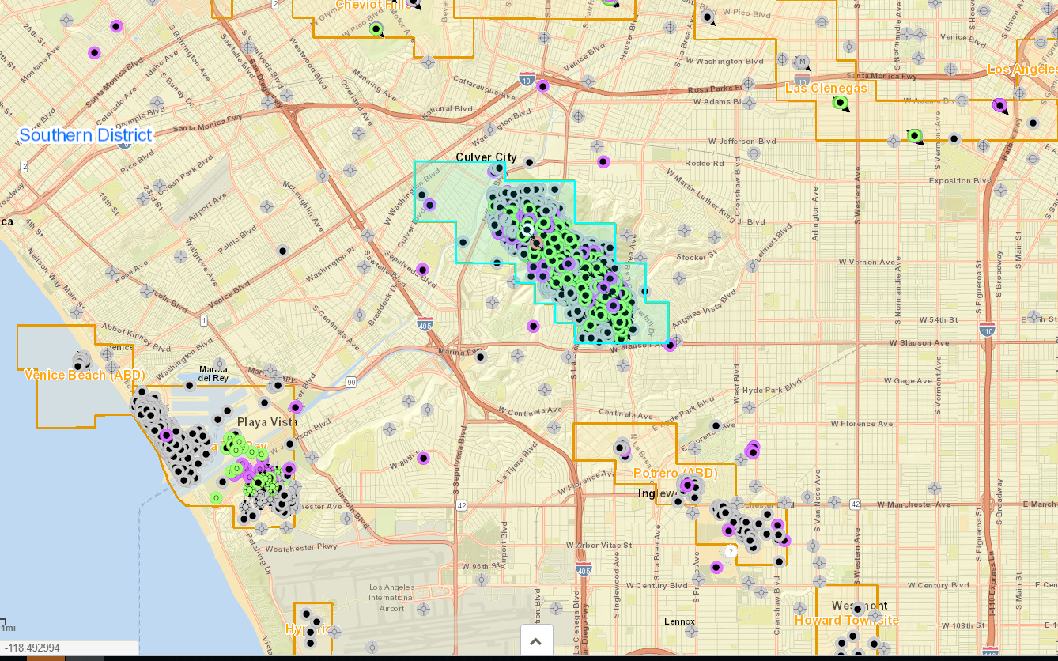
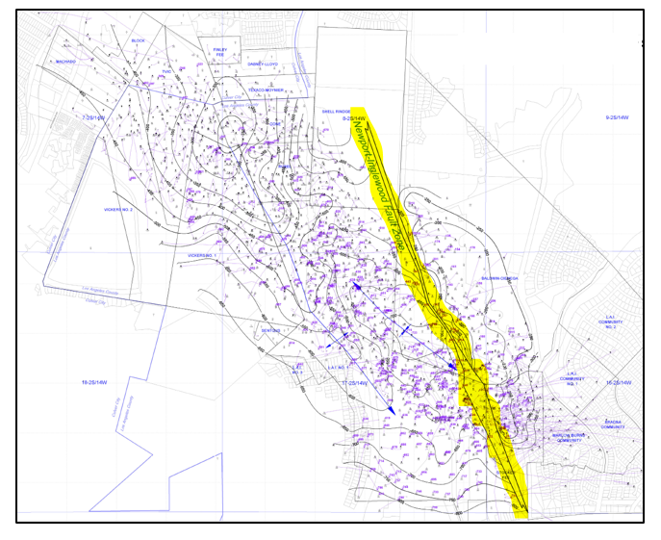
Inglewood Oil Field Boundary
Field Boundary
Newport-Inglewood Fault

Slide 13
Inglewood Oil Field Productive Zone
Reservoir Characteristics
Reservoir Zone Properties | Vickers-Rindge | Rubel | Moynier
Depth, ft | 1,400-3,500 | 3,500-4,300 | 4,300-5,300
Thickness, ft | 10-150 | 50-150 | 100-500
API Gravity, degrees | 18-28 | 25-28 | 25-28
Porosity, % | 25-32 | 26 | 18-22
Permeability, mD | 465-750 | 200-250 | 40
Initial Oil Saturation, % | 70 | 65-70 | 65-70
Est. Residual Oil Saturation, % | 38 | 45-55 | 60-63
Initial Reservoir Pressure, psia | 570-1150 | 1,500 | 2,800
Current Reservoir Pressure, psia | 470-535 | 520-1,100 | 584-2,475
Current Reservoir Temperature, deg F | 130 | 145 | 160
Water TDS, ppm | 23,000 | 30,000 | 24,000

Slide 14
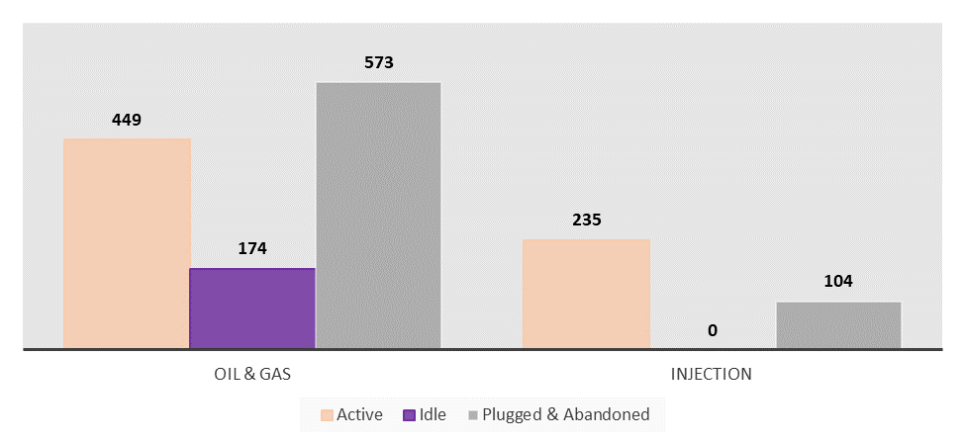
Inglewood Oil Field - API Wellhead Count

Slide 15
Inglewood Oil Field - Recent CalGEM Permits Issued
*Permits valid for 24 months from the issue date

Slide 16
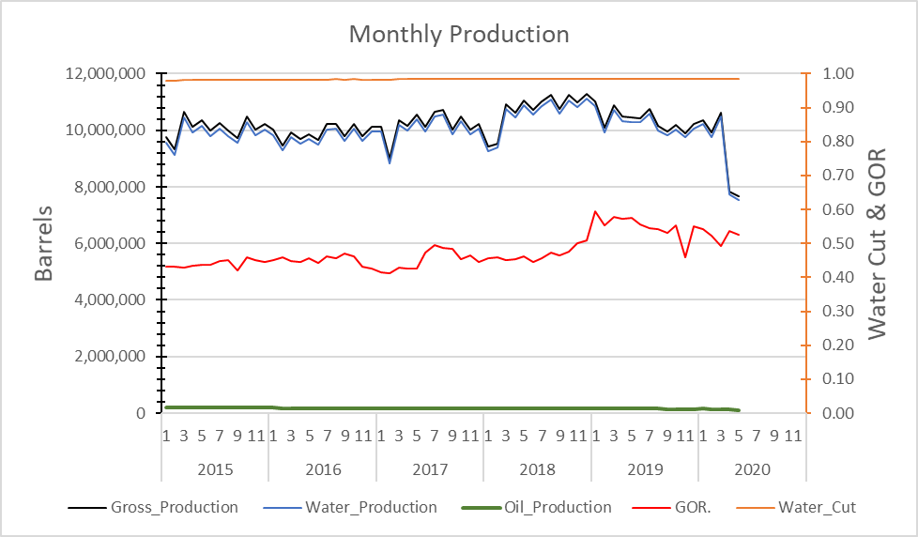
Inglewood Oil Field - Monthly Production Past 5 Years

Slide 17
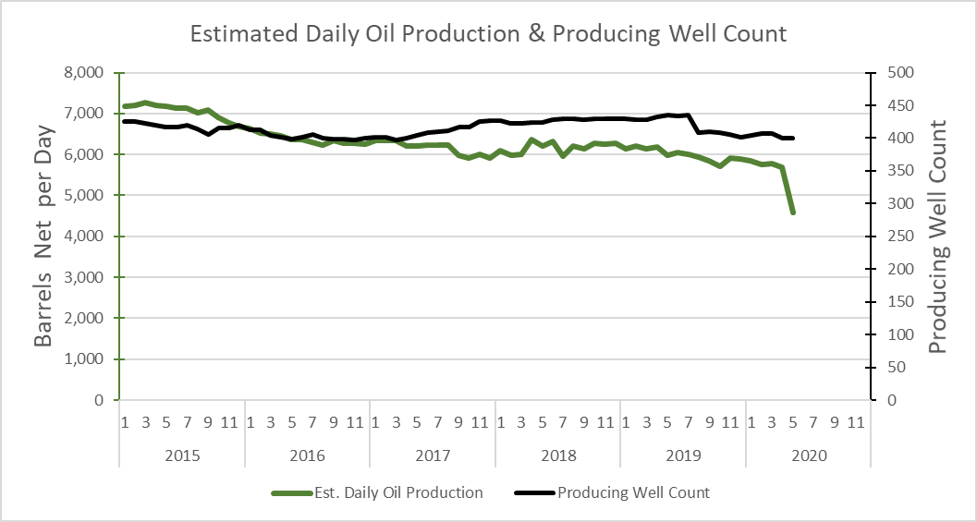
Inglewood Oil Field - Daily Production Past 5 Years

Slide 18
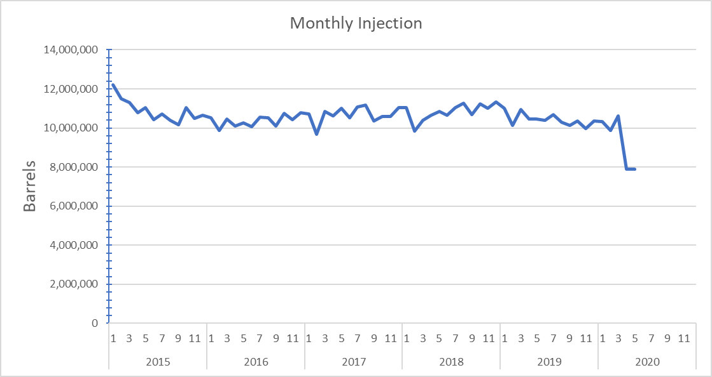
Inglewood Oil - Field Monthly Injection Past 5 Years

Slide 19

Inglewood Oil Field - Current Issues of Interest
High-visibility operations
Complex Area of Reviews – high density of wellbores
Multiple overlapping agencies
Groundwater monitoring program
  2019 analysis: fluid injection and production balanced in all reservoirs and ground movement below threshold
In the past 3 years, the operator has not received any violations

Slide 20
CARB SNAPS Study Summary

Slide 21
Study of Neighborhood Air Near Petroleum Sources (SNAPS)
Conducted by: California Air Resources Board (CARB)
Purpose: Study neighborhood air quality close to oil and gas extraction facilities.
Motivation:
  Exposure concerns from community
  Aliso Canyon underground natural gas storage leak
  California Council on Science and Technology recommendation
  CARB effort to understand impacts of oil and gas operations
Program Goals:
  Characterize air quality
  Identify nearby pollution sources
  Analyze data to assess hazards and risks

Slide 22

THANK YOU
Questions & Answers

